Slide 1
Chess Game
Group 3: Ethan, victor, megan, matthew

Slide 2

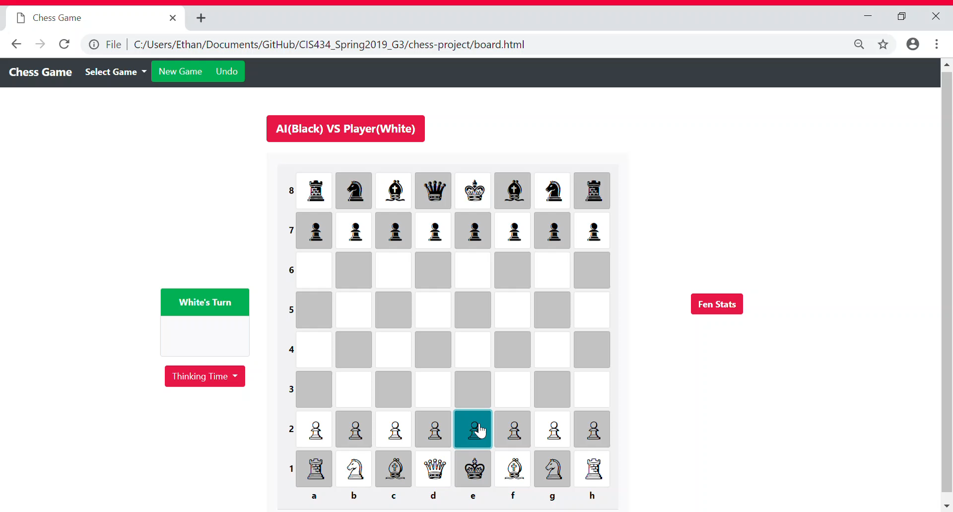
Piece Movement
Select a piece.
The legal moves for that piece will be highlighted in light-blue.
Select one of the highlighted squares to move the piece.
To cancel a selection, either click on the selected piece, or a non-highlighted square.

Slide 3
AI Research and implementation

Slide 4

How chess ai works
When a human mind is exposed to something new, the initial trails of implementing the new knowledge contain many rounds of error. Early defeats are due to the human not recognizing certain configurations and having a lack of experience when it comes to different strategies and tricks
As the human practices, the skill develops
Chess is a game that requires higher level abstract thinking and to know board patterns all while thinking ahead of your opponenent.

Slide 5
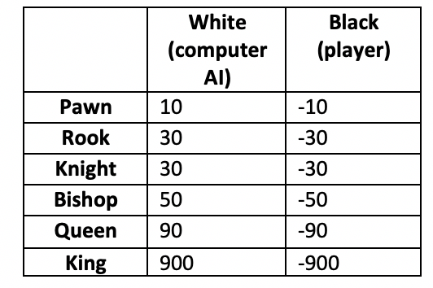
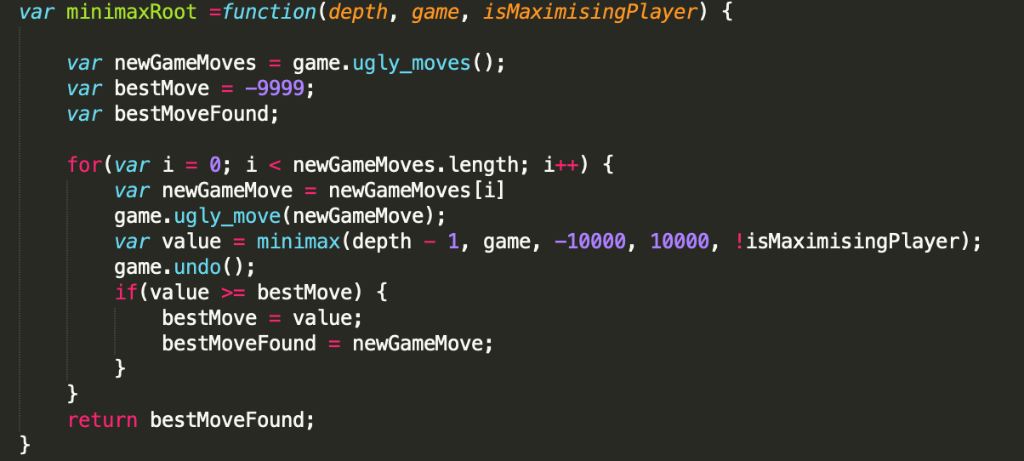
Position evaluation
After an initial algorithm that allows a game to be played is implemented, the computer needs to figure out what side is stronger in the current game state.
This allows the algorithm to choose the move that has the highest evaluation instead of choosing any on e of the possible moves at random.

Slide 6
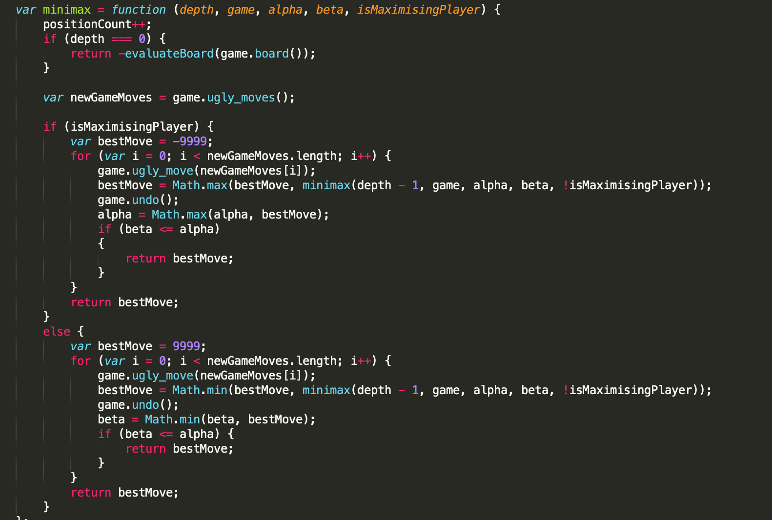
Search tree using minimax
It is assumed that both the computer and the human player will play the best moves.
A recursive tree of all possible moves is explored and the position is evaluated at the ending leaves of the tree.
The value of the child node is returned to either minimize or maximize the outcome at each level– this depends on whose move it is.

Slide 7
Search tree using minimax
The reason the minimax algorithm was chosen was because this backtracking algorithm is best suited for decision making and game theory.
The computer is able to search a game tree of all possible moves and counter moves, before evaluating each move and determining which is the best move on its turn, and the worst move when it is its opponent’s turn.

Slide 8
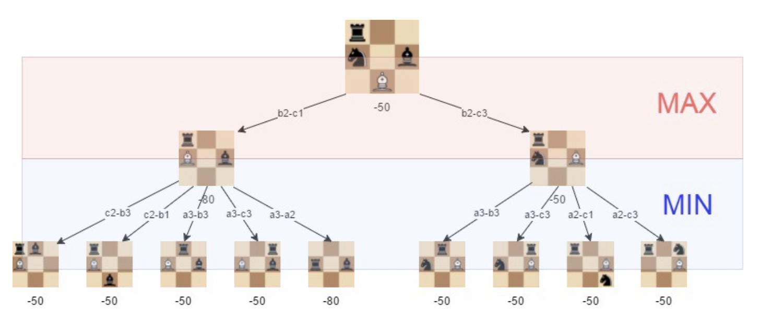
Position evaluation
The current state of the game is the root of the tree. (drawn at the top)
This node’s children representing all of the possible moves the computer can make.
Each of those nodes has children representing the game state after each of the opponent’s moves, and so on.
The leaves of the tree are the final state of the game– where no further move can be be made either due to a tie, or one player winning.

Slide 9

Additional algorithm implementation
If the computer is faced with only a few possible moves, the run time is low. On the other hand, if the computer is faced with a lot of options that it has to outweigh against each other possible outcome, it will take significantly longer for the computer to decide which possible move will be the most favorable given the current board state.
The ‘alpha-beta pruning” technique allows the computer to “prune” branches of the minimax algorithm search tree that yields less favorable results.
Given more time, this algorithm would help reduce run time further.

